Slide 1
Azure Virtual Machines

Slide 2
IaaS Cloud Services
IaaS is an instant computing infrastructure, provisioned and managed over the Internet.
On-demand, scalable

Slide 3
Business Scenarios
Test and Development
Website Hosting
Storage, backup and recovery
Web Apps
High-performance computing
Big data analysis
Extended Datacenter

Slide 4
Planning Checklist
Start with the network – Virtual networks are used in Azure to provide private connectivity between Azure Virtual Machines
Name the VM
Decide location for the VM
Determine the size of the VM
Pricing model
Storage for the VM
Supporting Operating System

Slide 5
Name the VM
Element | Example
Environment | Dev, Prod, QA
Location | Uw, ue
Instance | 01, 02, 03, 04, 05
Product or service | service
Role | Sql, web, messaging
Devusc-webvm01 – First development web server hosted in the US South Central location

Slide 6
Location
The location can limit your available options
There are price differences between locations

Slide 7
Pricing
Compute – Priced on per-hour basis but billed on per-minute basis
Consumption-based
Reserved Virtual Machine Instances
Storage – You are charged separately for the storage the VM uses.

Slide 8
Virtual Machine Sizing
General Purpose
Compute Optimized
Memory Optimized
Storage Optimized
GPU
High Performance Compute
https://docs.microsoft.com/en-us/azure/virtual-machines/sizes
Note: Be cautious when resizing production VMs

Slide 9







Virtual Machine Disk
OS Disk – Operating System Installed
Temporary Disk – Non-Persistent storage
Data Disk

Slide 10
Supported Operating System
Windows
Linux

Slide 11
Connect to VM
Windows – RDP - 3389
Linux – SSH - 22

Slide 12
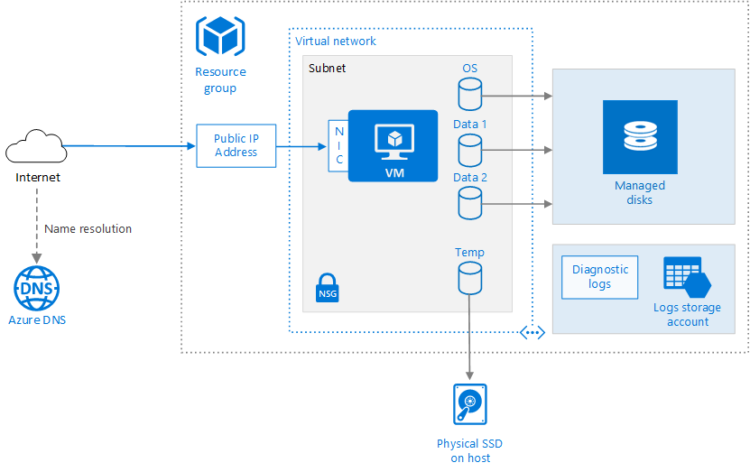

Slide 13
Create a VM
Windows 10
East US
DS2v2 Configuration

Slide 14






Stop the VM
Auto Shutdown
Shutdown
Disconnect
Power Off
Closing the RDP
Stop / Terminate from Portal, Cli, Ps
Deallocate

Slide 15
Create an Image

Slide 16
Virtual Machine Availability

Slide 17
Maintenance and Downtime
Unplanned Hardware Maintenance – Live Migration
Unexpected Downtime - Heals
Planned Maintenance – Periodic Updates

Slide 18
High Availability
Availability Set
Availability Zone
Virtual Machine Scale Set

Slide 19
Service Level Agreement
Single VM with Premium Disk – 99.90%
Availability Set – 99.95%
Availability Zone – 99.99%

Slide 20
Availability Set
Logical feature used to ensure that a group of related VMs are deployed so that they are not all subjected to a single point of failure.

Slide 21

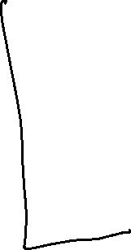




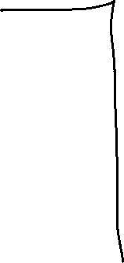



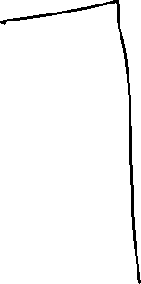
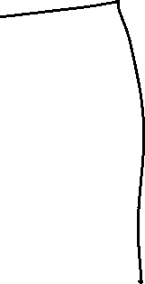


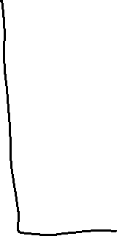

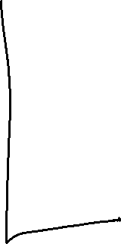


Slide 22

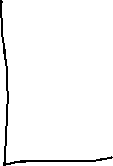
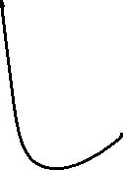










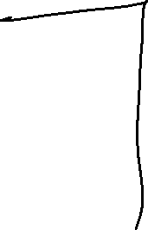
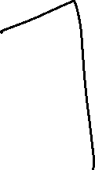


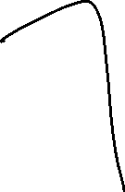


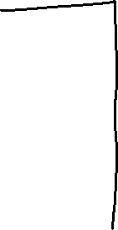




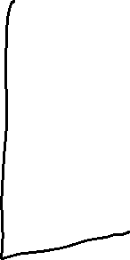

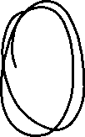

Slide 23
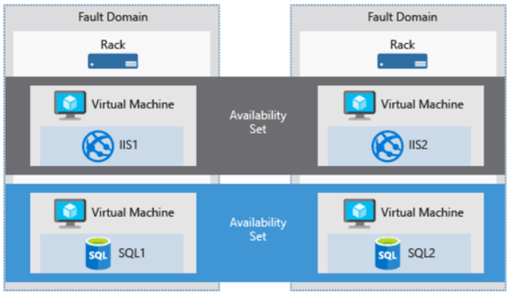
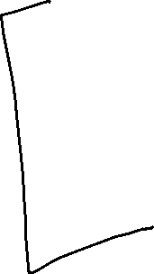
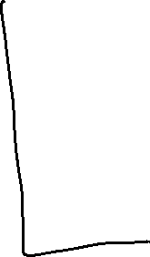

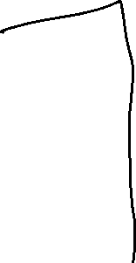
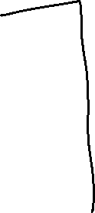

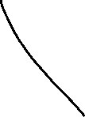
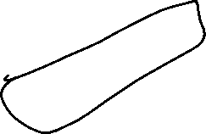

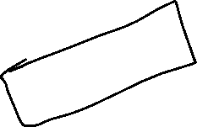


Slide 24
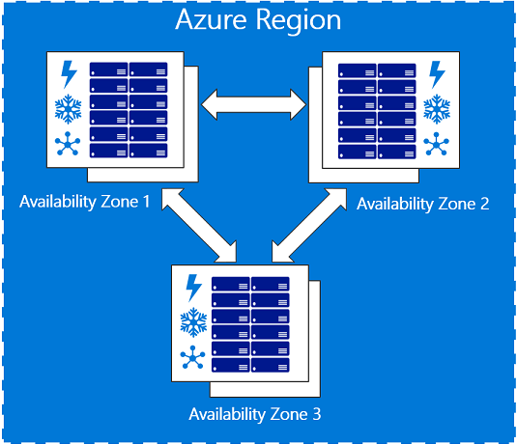








Availability Zone

Slide 25
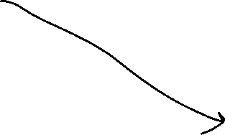


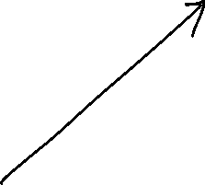
Virtual Machine Scale Set
Deploy and manage a set of identical VMs.
Autoscale

Slide 26
Benefits of VMSS
All the VM instances created are from the same base OS image and configuration
Azure Load balancer and Azure Application Gateway
Run multiple instances of application
Scale upto 1000 VM instances

Slide 27

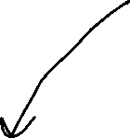

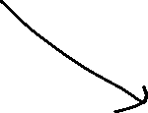












Autoscale
Automatically adjust capacity
Scale Out
Scale In
Schedule events
Less Overhead

